Slide 1
Radiological Toolbox 3.0.0 Training
Health Physics Society
50th Midyear Meeting
Shaheen Dewji, Ph.D.
Center for Radiation Protection Knowledge
Oak Ridge National Laboratory
crpk@ornl.gov
22-25 January, 2017

Slide 2
Radiological Toolbox 3.0.0 - Outline
Meet the Developers
Introduction to Radiological Toolbox 3.0.0
Radiological Toolbox Functionality
Demo (7)
Slide Acknowledgements:
Casper Sun (NRC)
Sami Sherbini (NRC)
Nolan Hertel (Georgia Tech/ORNL-CRPK)

Slide 3
Meet the Developers

Slide 4
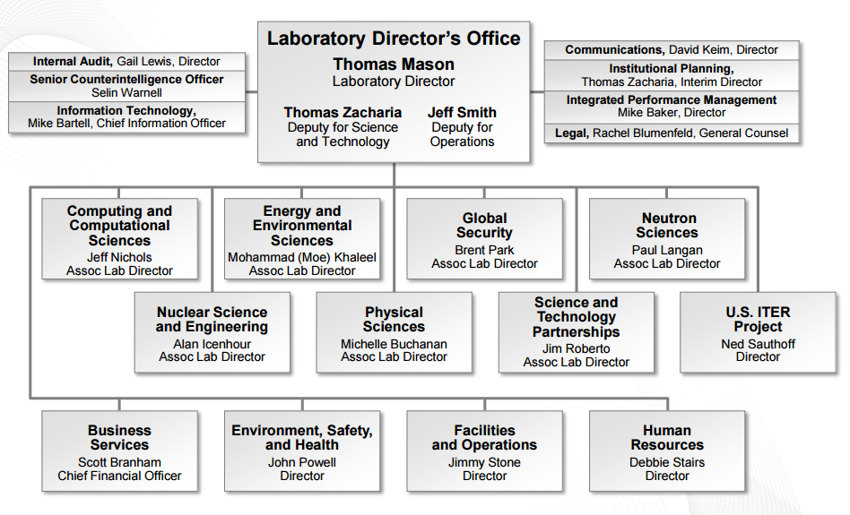
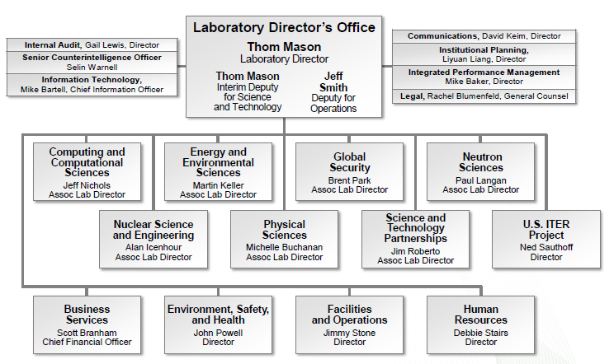
Oak Ridge National Laboratory

Slide 5
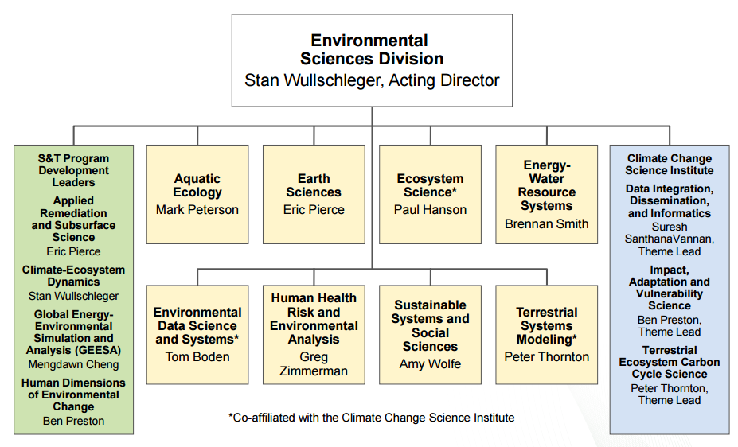
Center for Radiation Protection Knowledge (CRPK)

Slide 6
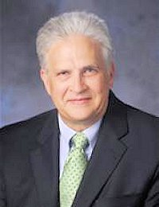
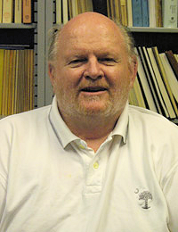



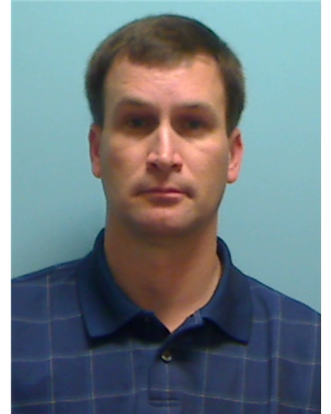
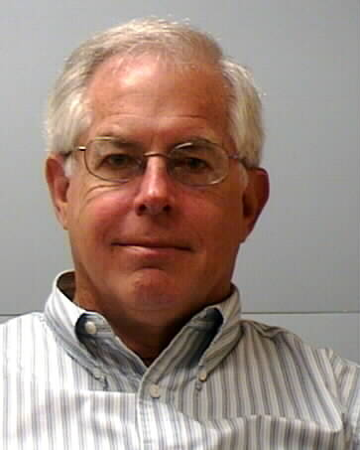



Center for Radiation Protection Knowledge
http://crpk.ornl.gov/
Top:
Nolan Hertel (JFA, Georgia Institute of Technology)
Keith Eckerman (Emeritus)
Rich Leggett (Senior R&D Scientist)
Middle:
Michael Bellamy (ORNL, R&D Engineer)
Shaheen Dewji (ORNL, R&D Engineer)
Derek Jokisch (JFA, Francis Marion U)
Bottom:
Clay Easterly (Consultant)
Ken Veinot (Consultant)
Pat Scofield (ORNL)
Scott Schwahn (ORNL)
Acknowledgement:
Mauritius Hiller

Slide 7
ORNL Dosimetry Research Program: The Legacy
Provided the national and international scientific communities with models and data
To estimate doses from exposure to radionuclides
To establish exposure guidelines for radionuclides.
These models generally have become international standards.
A center for archival and computer implementation of biokinetic and dosimetric models.
Notes:
ORNL Dosimetry Research Program was started in the 1950s by K. Z. Morgan, Director of ORNL’s Health Physics Division
Morgan early recipient of the Swedish Royal Academy Gold Medal for Radiation Protection.
From 1979 – 2012, program was led by Keith Eckerman
Most recent recipient of the Swedish Royal Academy Gold Medal for Radiation Protection
Now part of ORNL’s Environmental Sciences Division.
Former members read like a Who’s Who in Radiation Protection

Slide 8

Center for Radiation Protection Knowledge (http://crpk.ornl.gov/)
Established at ORNL per MOU 2010
DOE, DoD, EPA, NRC, and OSHA
MOU Renewal in 2015
Objectives
Maintaining/Preserving U.S. expertise and leadership
Development/Application of Radiation Dosimetry and Risk Assessment Methodologies/Models
Ensure the best scientifically available knowledge in regulatory processes and decision making
Notes:
Interagency Steering Committee on Radiation Standards

Slide 9
Introduction to Radiological Toolbox 3.0.0

Slide 10

Radiological Toolbox Software
Developed for the NRC
K.F. Eckerman, A.L. Sjoreen, “Radiological Toolbox User’s Guide”, ORNL/TM-2013/16, 2013
Provide electronic access to a vast and varied array of data for radiation protection and shielding
Physical, chemical, anatomical, physiological, and mathematical parameters that normally requires access to multiple sources
Latest release/update is version 3.0.0
Available at https://www.usnrc-ramp.com/Radiological-Tools

Slide 11
Radiological Toolbox User's Guide (NUREG/CR-7166, ORNL/TM-2013/16)
Provides electronic access to the vast and varied data that underlies the field of radiation protection.
The initial motivation was to serve the needs of the health physicist away from his office, e.g., NRC inspectors
Earlier releases were widely used and accepted around the world by not only practicing health physicists but also those within educational programs
Version 3.0.0
Updated to run on Windows 7 and 8 and on 32- and 64-bit machines
Nuclear decay data updated and now includes thermal neutron capture cross sections and cancer risk coefficients

Slide 12
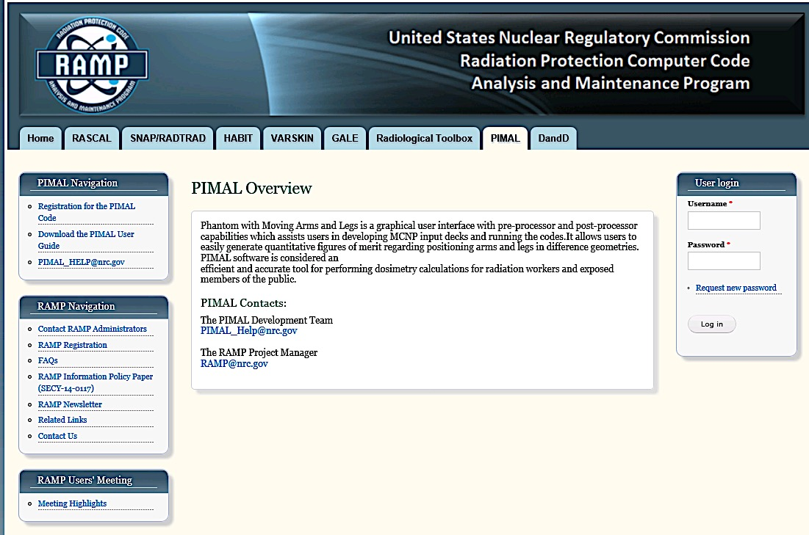
RadToolbox
Available (registration required) on U.S. Nuclear Regulatory Commission Radiation Protection and Computer Code Maintenance Program (RAMP)
NRC RAMP Website | RAMP Website
https://www.usnrc-ramp.com
ORNL inquiry:
crpk@ornl.gov

Slide 13
Radiological Toolbox Functionality

Slide 14
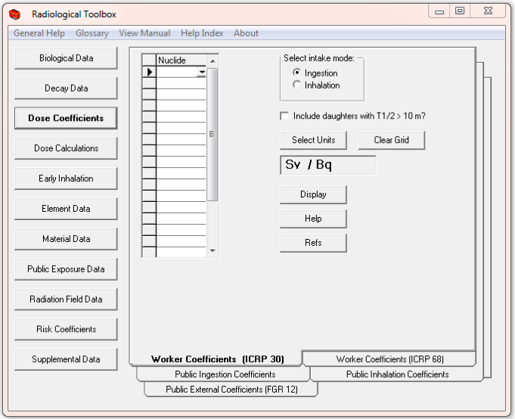
RadToolbox Interface

Slide 15
Biological Data
Biokinetic Models from ICRP 68 and 72
Bioassay Data - urinary and fecal excretion data and retention data
Composition of Tissues from Coursey
Organ Masses from ICRP Publications 23, 72, and 89
ICRP 89 - extensive set of anatomical and physiological reference values
Radiation Health Effects
deterministic and stochastic
summarized from various source

Slide 16
Decay Data
Detailed radionuclide energy-intensity emission data
ICRP Publication 107 data
NNDC ENSDF - input data into the analysis
Updated if necessary to those of NUBAS2003 and AME2003
Radionuclide activity including the building of radioactive progeny can be calculated
Option to export Tables of energy-intensity data to EXCEL
ICRU-defined air kerma-rate constant air-kerma coefficient for the radionuclides
The decay chain table includes the specific activity, half-life, decay mode, and identification of radioactive progeny with their branching fractions

Slide 17
Dose Coefficients
External Environmental Dose Coefficients - 826 radionuclides from FGR12
Committed Dose Coefficients for inhalation and ingestion – 738 radionuclides
Workers from ICRP 30 and 68
Age-dependent members of the public (six ages at intake) from ICRP 72.
Display up to 20 nuclides at a time for a chosen route of exposure or intake.
Exportable to EXCEL spreadsheet
Organ equivalent dose and the effective dose for the selected radionuclide

Slide 18
Dose Calculations
Simple numerical calculations of dose for a mixture of radionuclides
Select appropriate dose coefficients, nuclides and activities
≤ 20 radionuclides
External exposure, total dose for the mixture
Intake of radionuclides
Dose for intake of each chemical form is reported and not the total.
User can export the table to EXCEL, delete columns of irrelevant chemical forms, and derive the total dose

Slide 19
Early Inhalation
Inhalation dose coefficients for deterministic health effects
Separate low- and high-LET values of absorbed dose are provided and the RBE can then be applied to the absorbed dose components
These absorbed dose coefficients may be exported to EXCEL

Slide 20
Risk Coefficients
Federal Guidance Report 13
Average member of the US public
Mortality risk coefficient per unit activity inhaled or ingested for internal exposures or per unit time-integrated activity concentration in air or soil for external exposure
Morbidity risk coefficient is a comparable estimate of the average total risk of experiencing a radiogenic cancer, whether or not the cancer is fatal
Data presented for 14 cancer sites

Slide 21
Element Data
Interaction coefficients for alpha, electron, photon, and neutron radiations in elemental absorbers.
Not available for every element or for each radiation type
Can be plotted
Geometric progression form of the photon buildup factors from ANSI Standard 6.4
0.015 and 15 MeV at distances ranging from 0.5 to 60 MFP
The photon and neutron kerma coefficients were taken from KERMAL, RSICC package DLC-143
Atomic mass and isotopic abundance data
16th edition of the Chart of the Nuclides
Can be exported to EXCEL

Slide 22
Public Exposure Data
Natural Background Radiation
Background Radiation in the Body
Radionuclides in Materials
Radionuclides in Devices
Primordial Radionuclides
Typical Exposures during Medical Procedures

Slide 23
Other Data
Radiation Field Data
ICRP Publication 74/ICRU Report 57 Dose Coefficients
Supplemental Data
SI Units
Physical Constants
Conversion Factors
International Nuclear and Radiological Event Scale (INES)
Formulas
Web Pages
DOE Dose Ranges
Transport Package Regulations (A1/A2 Table)

Slide 24
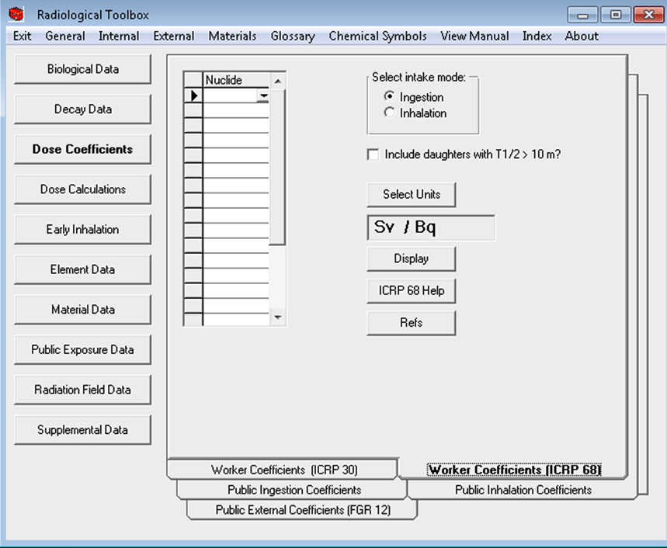
RadToolbox – Future Outlook
Time for a smart phone version?

Slide 25
Radiological Toolbox Demo a.k.a. “Homework”
The following questions and solutions were designed by Dr. Sami Sherbini, US-NRC.

Slide 26
Question 1
Calculate committed effective does from repair work in areas where the airborne concentration of ⁶⁰Co (Type W) is 4x10³ Bq m^{‐3}. The workers will be remaining in this for 2.5 hours. What are the results from using ICRP‐26 and ICRP‐60 dose coefficients (Sv/Bq)?

Slide 27
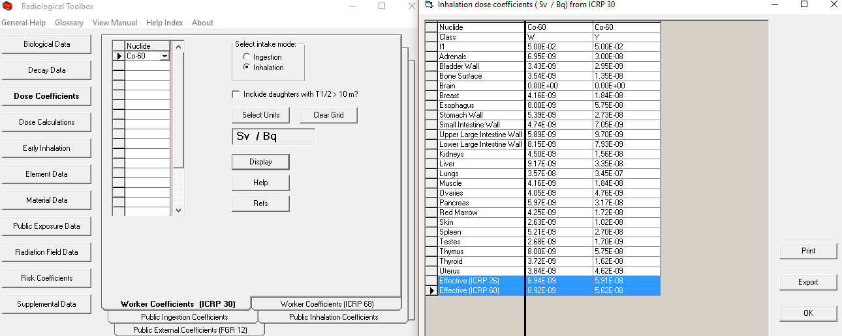
Question 1

Slide 28
Solving Question 1
Click Dose Coefficients tab.
Click Worker Coefficients (ICRP 30) tab.
Click Units and choose Sv/Bq (this is the default).
Enter Co and select Co-60 from the Nuclide drop down menu.
Select the Inhalation button for intake mode.
Click the Display tab.
Read off the dose coefficients for Type W:
8.94E‐9 Sv/Bq for ICRP 26
8.92E‐9 Sv/Bq for ICRP 60
The coefficients show that for ⁶⁰Co, there is little difference between ICRP26 and ICRP 60.

Slide 29
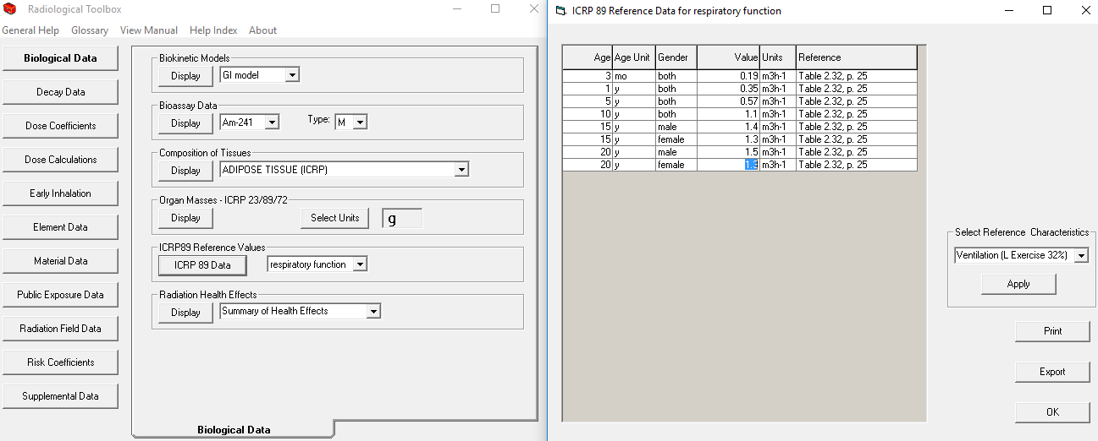
Solving Question 1
Click OK to close the Dose Coefficient window.
Click the Biological Data tab.
Under the ICRP‐89 Reference Values tab, select Respiratory Functions from the drop‐down menu.
Click ICRP89 Data tab.
Select Ventilation (L Exercise) from the dropdown menu.
Read the rate of 1.3 m³/hr for a female worker.

Slide 30
Solution 1
Committed effective dose
= 8.92x10^{‐9} (Sv/Bq) x 1.3 (m³/hr) x 2.5 (hr) x 4x10⁵ (Bq/m³)
= 11.6 mSv (1.16 rem)

Slide 31
Question 2
The concentration of ¹³¹I (Type F) in air in an unrestricted area is 3x10² Bq/m³. Assuming this concentration to remain constant over a period of one year, and using ICRP-60 data
What is the dose coefficient in this case for a 1 year-old child and for an adult?
What is the ratio of these coefficients?
What would be the effective dose to the child and to the adult as a result of the 1 year exposure?
What is the ratio?

Slide 32
Question 2 (a) and (b)
The concentration of ¹³¹I (Type F) in air in an unrestricted area is 3x10² Bq/m³. Assuming this concentration to remain constant over a period of one year, and using ICRP-60 data
What is the dose coefficient in this case for a 1 year-old child and for an adult?
What is the ratio of these coefficients?
What would be the effective dose to the child and to the adult as a result of the 1 year exposure?
What is the ratio?

Slide 33
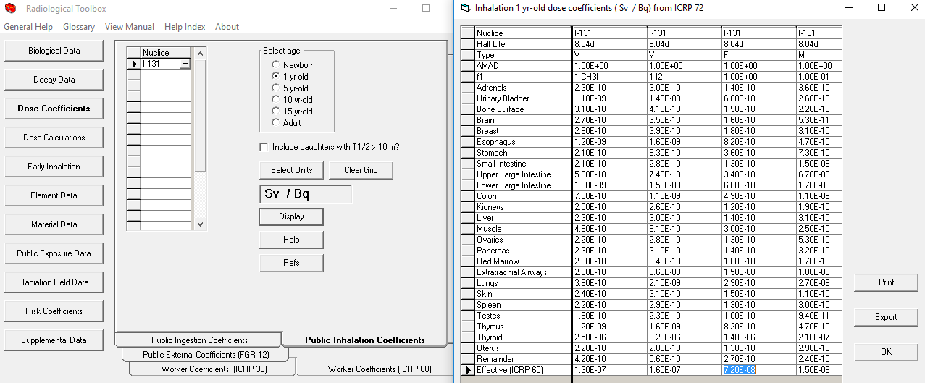
Question 2 (a) and (b)

Slide 34
Solving Question 2 (a) and (b)
Click Dose Coefficients tab.
Click Public Inhalation Coefficients.
Select I-131 from the drop‐down nuclide menu,
1 year old button from the age menu.
Click Display.

Slide 35
Solution 2 (a) and (b)
a) Child (1‐y) = 7.2E‐8 Sv/Bq
Adult (>17) = 7.4E‐9 Sv/Bq
b) Ratio of dose coefficients (Child/Adult) = 7.2E‐8/7.4E‐9 = 9.7

Slide 36
Question 2 (c) and (d)
The concentration of ¹³¹I (Type F) in air in an unrestricted area is 3x10² Bq/m³. Assuming this concentration to remain constant over a period of one year, and using ICRP-60 data
What is the dose coefficient in this case for a 1 year-old child and for an adult?
What is the ratio of these coefficients?
What would be the effective dose to the child and to the adult as a result of the 1 year exposure?
What is the ratio?

Slide 37
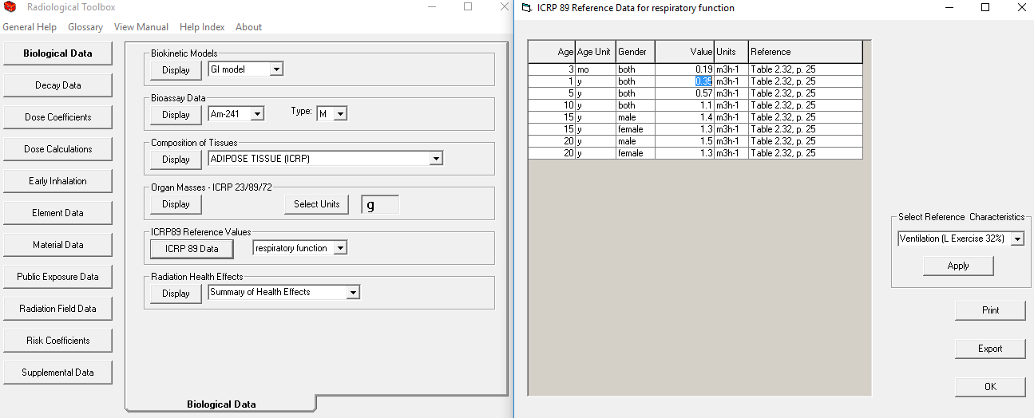
Question 2 (c) and (d)

Slide 38
Solving Question 2 (c) and (d)
Click Biological Data.
ICRP‐89 Reference Values.
Respiratory Function, Ventilation, Light Exercise:
Child = 0.35 m³/hr Adult = 1.5 m³/hr

Slide 39
Solution 2 (c) and (d)
c) The annual doses are:
Child:
D = 7.2E‐8 Sv/Bq x 300 Bq/m³ x 0.35 m³/hr x 8760 hr/yr x 1 yr = 0.066 Sv
Adult:
D = 7.4E‐9 Sv/Bq x 300 Bq/m³ x 1.50 m³/hr x 8760
hr/yr x 1 yr = 0.029 Sv
d) Ratio of annual dose (Child/Adult) = 0.066/0.029 = 2.3
Although the ratio of dose coefficients is 9.7, the ratio of annual doses is 2.3. The reason for this difference in ratios is the difference in breathing rates.

Slide 40
Question 3
A worker is suspected of having inhaled airborne ¹³⁴Cs (Type F) and was asked to collect a 24-hour urine sample. The sample was collected 5 days following the suspected intake incident, and showed an activity of 50 Bq/mL of urine. The volume of urine was 950 mL.
What is the estimated intake?
What is the resulting effective dose?
Which organ receive the highest dose from this exposure and does it exceed the 0.5 Sv imposed by US regulations on organ dose?

Slide 41
Question 3 (a)
A worker is suspected of having inhaled airborne ¹³⁴Cs (Type F) and was asked to collect a 24-hour urine sample. The sample was collected 5 days following the suspected intake incident, and showed an activity of 50 Bq/mL of urine. The volume of urine was 950 mL.
What is the estimated intake?
What is the resulting effective dose?
Which organ receive the highest dose from this exposure and does it exceed the 0.5 Sv imposed by US regulations on organ dose?

Slide 42
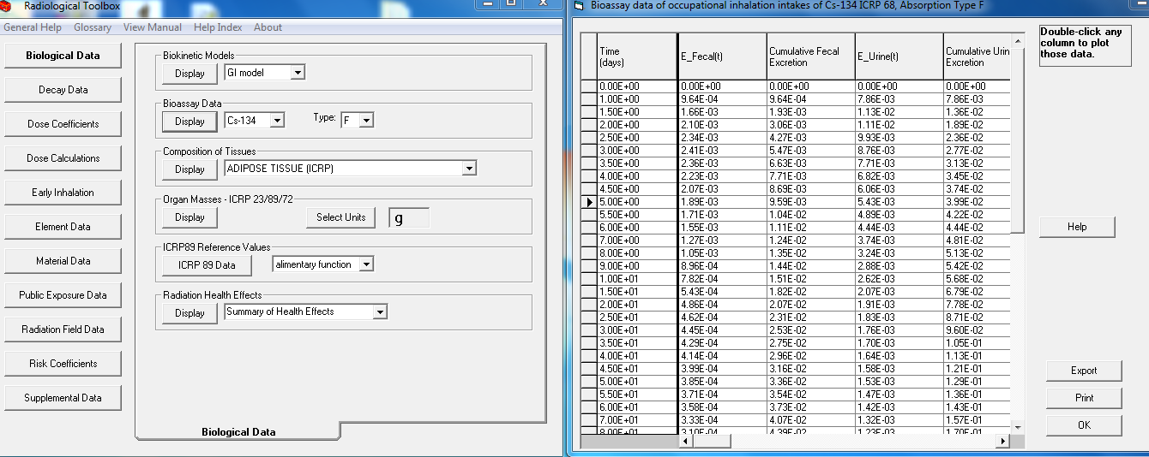
Solving 3 (a)
Click the Biological data tab.
In the Bioassay Data tab, select Cs-134 and select Type F and click Display.
In the E_Urine(t) column select the row corresponding to 5 days and read the value 5.43E‐3.
This is the urine excretion fraction for that time post‐intake.

Slide 43
Solution 3 (a)
Intake =
(50 (Bq/mL) x 900 (mL))/5.43E‐3 = 8.29E6 Bq

Slide 44
Question 3 (b)
A worker is suspected of having inhaled airborne ¹³⁴Cs (Type F) and was asked to collect a 24-hour urine sample. The sample was collected 5 days following the suspected intake incident, and showed an activity of 50 Bq/mL of urine. The volume of urine was 950 mL.
What is the estimated intake?
What is the resulting effective dose?
Which organ receive the highest dose from this exposure and does it exceed the 0.5 Sv imposed by US regulations on organ dose?

Slide 45
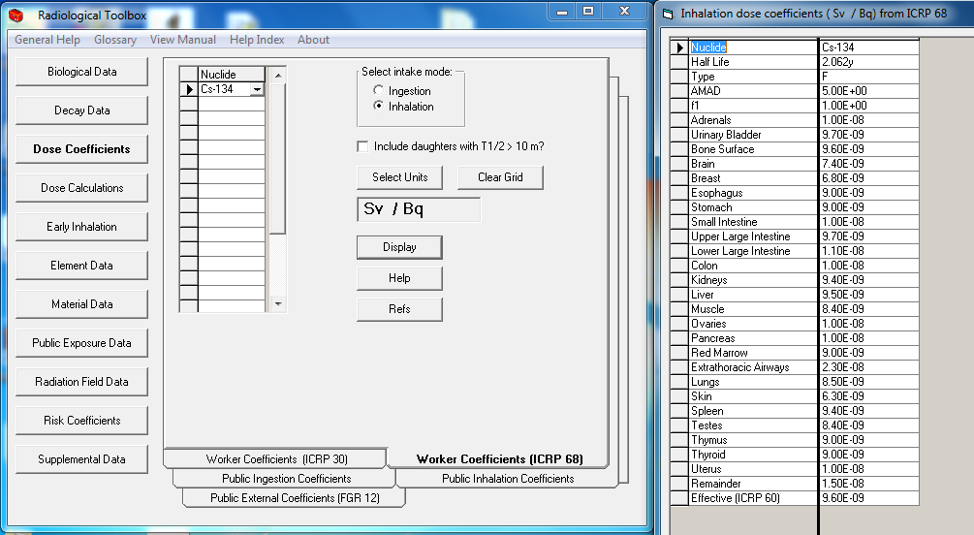
Solving 3 (b)
Click Dose Coefficient tab.
ICRP‐68 worker data
Select Inhalation of Cs-134,
b) Effective dose coefficient is 9.6E‐9 Sv/Bq.

Slide 46
Solution 3 (b)
Committed effective dose
= 9.6E‐9 (Sv/Bq) x 8.29E6 (Bq)
= 0.08 Sv

Slide 47
Question 3 (c)
A worker is suspected of having inhaled airborne ¹³⁴Cs (Type F) and was asked to collect a 24-hour urine sample. The sample was collected 5 days following the suspected intake incident, and showed an activity of 50 Bq/mL of urine. The volume of urine was 950 mL.
What is the estimated intake?
What is the resulting effective dose?
Which organ receive the highest dose from this exposure and does it exceed the 0.5 Sv imposed by US regulations on organ dose?

Slide 48
Solution 3 (c)
Using the limit of 0.5 Sv for any organ, and an intake of 8.29E6 Bq, any organ with a dose coefficient greater than 0.5/8.29E6 = 6.0E‐8 Sv/Bq will exceed the limit.
A review of the dose coefficient table shows that none of the organs exceeds that dose.

Slide 49
Question 4
What is the mean energy and the end-point energy of the beta spectrum emitted by ³²P?
What is the CSDA range, gm/cm² of electrons with this end-point energy in leaded glass? What fraction of the beta energy is going to be converted to bremsstrahlung radiation?

Slide 50
Question 4 (a)
What is the mean energy and the end-point energy of the beta spectrum emitted by ³²P?
What is the CSDA range, gm/cm² of electrons with this end-point energy in leaded glass? What fraction of the beta energy is going to be converted to bremsstrahlung radiation?

Slide 51
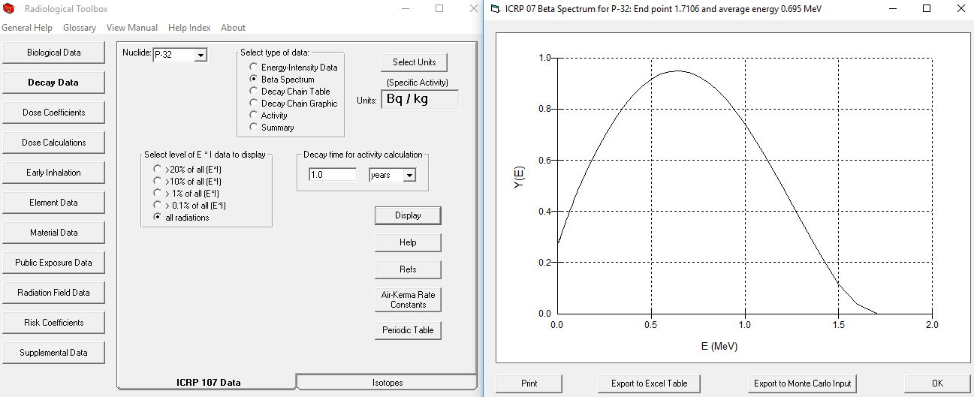
Solving 4 (a)
Click the Decay Data tab.
Select the ICRP‐107 Data tab.
Select P-32 from the Nuclide drop‐down menu.
Select the Beta Spectrum button.
Click Display. The average and end‐point energies are shown at the top of the beta spectrum.

Slide 52
Solution 4 (a)
End‐point = 1.7106 MeV
Average = 0.695 MeV

Slide 53
Question 4 (b)
What is the mean energy and the end-point energy of the beta spectrum emitted by ³²P?
What is the CSDA range, gm/cm² of electrons with this end-point energy in leaded glass? What fraction of the beta energy is going to be converted to bremsstrahlung radiation?

Slide 54
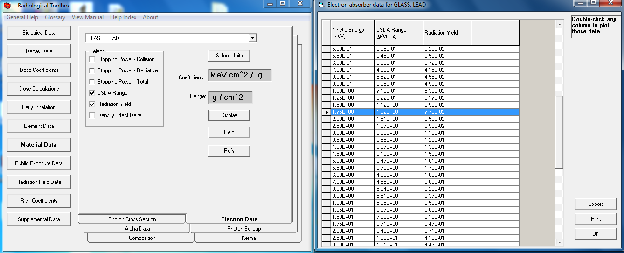
Solving 4 (b)
Click the Material Data tab.
Select the Electron Data tab.
Select Glass, Lead from the material drop‐down menu.
Check the CSDA Range and the Yield buttons.
Click Display.
Read the CSDA and Yield

Slide 55
Solution 4 (b)
The values at 1.75 MeV may be considered close enough, or interpolation may be used between values at 1.50 and 1.75 MeV.
CSDA: 1.32 g/cm²
Yield: 7.78E‐2 (7.78%)

Slide 56
Question 5
For an adult worker, what fraction of a 1000 Bq inhalation of a Type S, 5 µm AMAD ⁵⁸Co aerosol is exhaled immediately after inhalation of that aerosol?
What fraction of the activity is deposited in the thoracic and in the extra-thoracic regions?
What activity in a 24-hour urine sample would you expect to find if the sample is taken 10 days after the intake?

Slide 57
Question 5 (a) and (b)
For an adult worker, what fraction of a 1000 Bq inhalation of a Type S, 5 µm AMAD ⁵⁸Co aerosol is exhaled immediately after inhalation of that aerosol?
What fraction of the activity is deposited in the thoracic and in the extra-thoracic regions?
What activity in a 24-hour urine sample would you expect to find if the sample is taken 10 days after the intake?

Slide 58
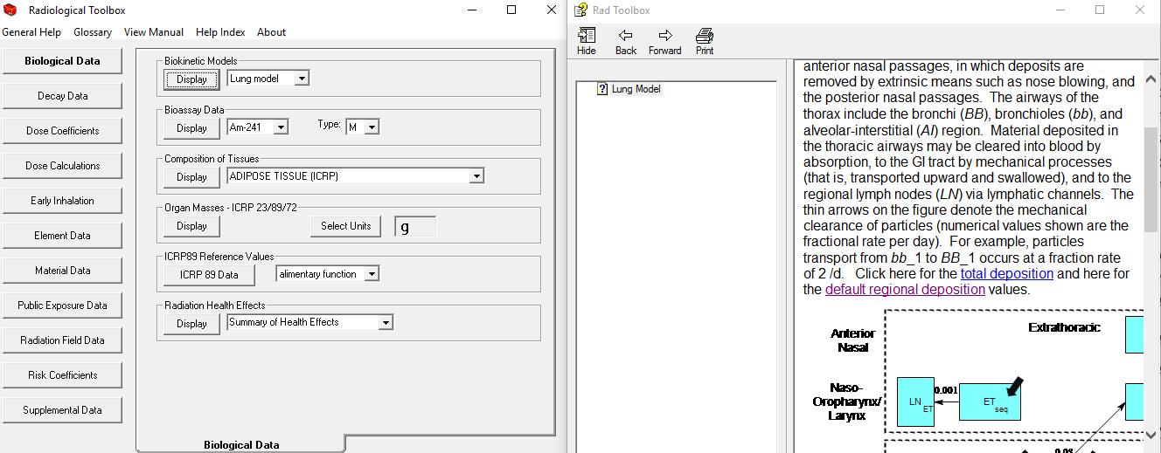
Solving 5 (a) and (b)
Click the Biological Data tab.
In Biokinetic Models, select Lung Model and click Display.
Click the Default Regional Deposition highlighted text.
In the table under AMAD = 5 microns, add the fractions deposited in the ET, BB, and BB and AI regions.

Slide 59
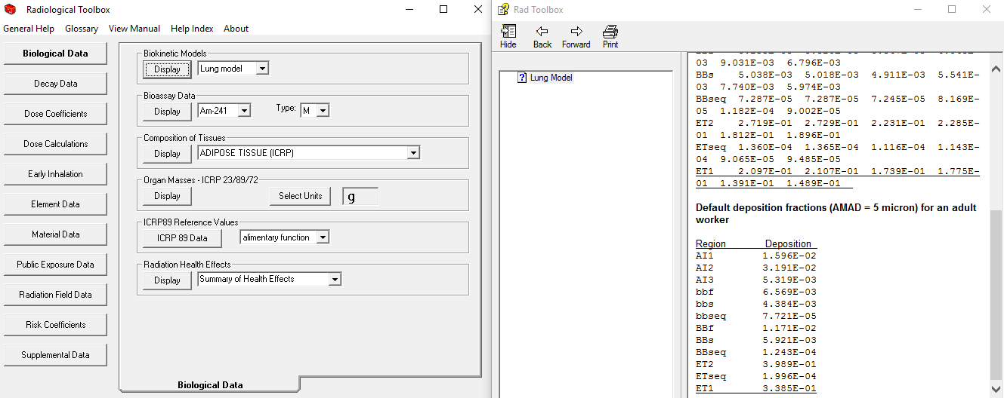
Solving 5 (a) and (b)
Click the Biological Data tab.
In Biokinetic Models, select Lung Model and click Display.
Click the Default Regional Deposition highlighted text.
In the table under AMAD = 5 microns, add the fractions deposited in the ET, BB, and BB and AI regions.

Slide 60
Solution 5 (a) and (b)
Deposition in ET = 73.76%
BB = 1.78%
bb = 1.09%
AI = 5.32%
Total Deposition = 81.93%
Amount exhaled = 18.1%
Note: ET1 corresponds to the nasal lings in a nose breather. According to the table, about 34% of the 5 micron aerosol is deposited there. Therefore, if a nose swab is taken, a qualitative idea of the possible intake is probably more than about three times the activity on the swab, depending on how much of the nasal deposit is collected on the swab.

Slide 61
Question 5 (c)
For an adult worker, what fraction of a 1000 Bq inhalation of a Type S, 5 µm AMAD ⁵⁸Co aerosol is exhaled immediately after inhalation of that aerosol?
What fraction of the activity is deposited in the thoracic and in the extra-thoracic regions?
What activity in a 24-hour urine sample would you expect to find if the sample is taken 10 days after the intake?

Slide 62
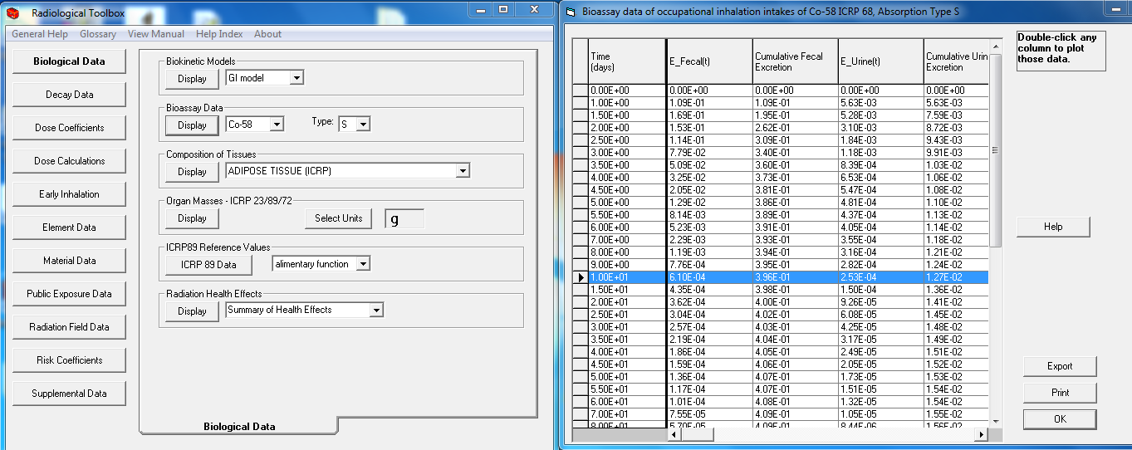
Solving 5 (c)
Click Biological Data
Select 58Co, Type S in Bioassay Data, and click display.
Under E_Urine, in the row corresponding to 10 days, read 2.53E‐4 (Bq/Bq-Intake).

Slide 63
Solution 5 (c)
Activity expected in the 24‐hour urine sample is:
Urine activity = 1,000 x 2.53E‐4 = 0.253 Bq.
This type of calculation is helpful to determine whether the available urine counting protocol and equipment are capable of measuring this level of
activity in the sample, given the methods used on site for routine bioassay intervals amounts of urine collected per sample, for example, a 24‐hour sample or a “grab” sample. The grab sample is taken from one voiding and therefore usually contains much less activity than a 24‐hour sample, and so required greater measurement capabilities to detect a given minimum intake level.

Slide 64
Question 6
What is the air kerma rate free-in-air at a location where the 0.08 MeV photon fluence is 2.24E8 photons/cm²?
What is the effective dose rate resulting from exposure to this beam when incident on the body in the AP direction at that location? What is the dose rate if the direction was PA with the same fluence rate? What is the rate if the radiation is isotropic?

Slide 65
Question 6 (a)
What is the air kerma rate free-in-air at a location where the 0.8 MeV photon fluence is 2.24E8 photons/cm²?
What is the effective dose rate resulting from exposure to this beam when incident on the body in the AP direction at that location? What is the dose rate if the direction was PA with the same fluence rate? What is the rate if the radiation is isotropic?

Slide 66
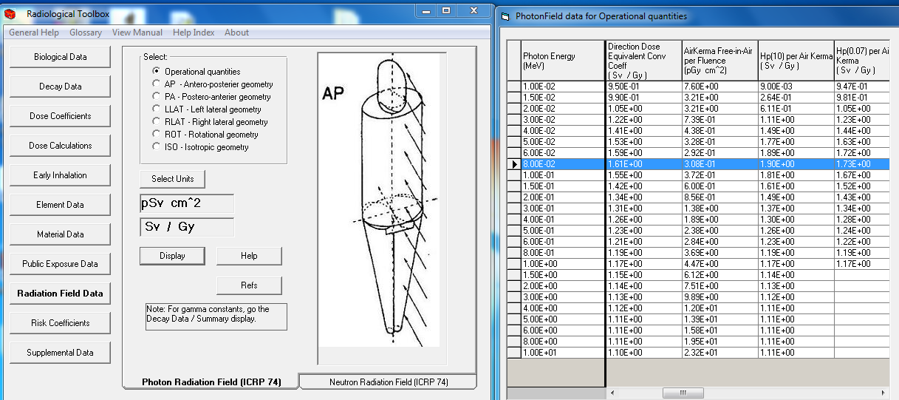
Solving 6 (a)
Click the Radiation Field Data tab.
Select the Operational quantities button.
Click Display.
The air kerma column at 0.8 MeV shows a kerma rate of 3.69 pGy‐cm².This unit may be interpreted as pGy per photon/cm² or the kerma per unit fluence.

Slide 67
Solution 6 (a)
The kerma rate corresponding to the 2.24E8 fluence is:
K = 2.24E8 x 3.69
= 8.27E8 pGy
= 0.827 mGy

Slide 68
Question 6 (b)
What is the air kerma rate free-in-air at a location where the 0.8 MeV photon fluence is 2.24E8 photons/cm²?
What is the effective dose rate resulting from exposure to this beam when incident on the body in the AP direction at that location? What is the dose rate if the direction was PA with the same fluence rate? What is the rate if the radiation is isotropic?

Slide 69
Solving 6 (b)
Click on the AP button on the same tab and read the effective dose coefficient (Sv/Gy) for AP, PA, and ISO incidence at 0.8 MeV are:
AP = 1.433
PA =1.019
ISO = 0.749

Slide 70
Solution 6 (b)
The dose rates are:
E(AP) = 0.827 (mGy/s) x 1.433 (Sv/Gy) * 0.001 (Gy/mGy)
= 0.0012 mSv/s
= 4.27 Sv/hr
E(PA) = 0.827 (mGy/s) x 1.019 (Sv/Gy) x 0.001 (Gy/mGy)
= 0.00084 mSv/s
= 3.03 Sv/hr
E(ISO) = 0.827(mGy/s) x 0.749 (Sv/Gy) x 0.001
(Gy/mGy)
= 0.00062 mSv/s
= 2.23 Sv/hr

Slide 71
Question 7
What is the risk resulting from continuous submersion for a year in a cloud of ⁸⁵Kr with a constant concentration of 1E3 Bq/m³?

Slide 72
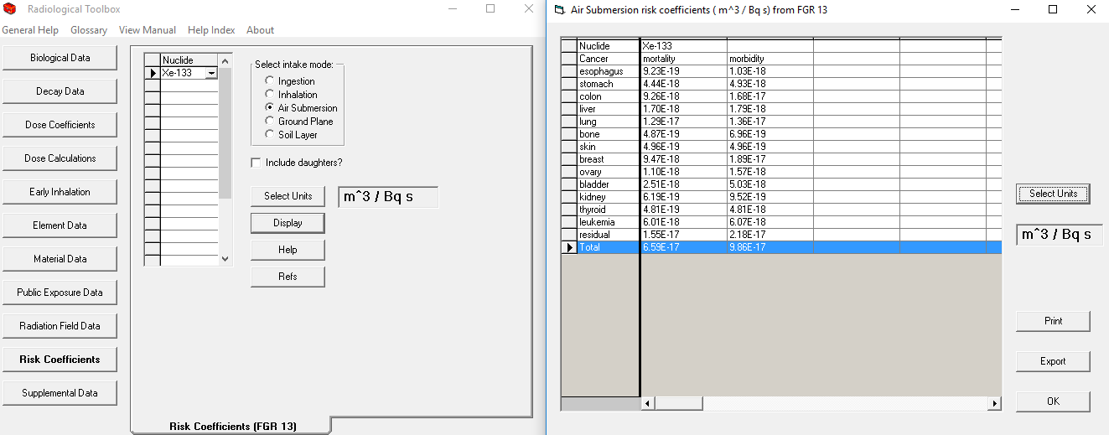
Solving 7
Click the Risk Coefficients button.
Select Xe‐133 from the Nuclides list.
Click Display.
The risk coefficients are:
Mortality = 6.59E‐17 m³/Bq‐s
Morbidity = 9.86E‐17 m³/Bq‐s

Slide 73
Solution 7
The integrated duration of exposure is:
X = 1E3 (Bq/m³) x 8760 (h/y) x 3600 (s/h)
= 3.154E10 (Bq‐s/m³)
Mortality risk
= 6.59E‐17 (m³/Bq‐s) x 3.154E10 (Bq‐s/m³)
= 2E‐6
Morbidity risk
= 9.86E‐17 (m³/Bq‐s) x 3.154E10 (Bq‐s/m³)
= 3E‐6

Slide 74
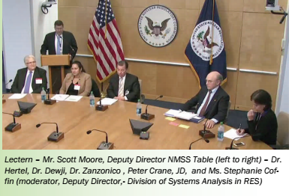
Questions?

